Slide 1
Application of Neural Networks on Air Quality Update
Timothy Quah

Slide 2
Where we left off last…
Problem: Sensor specific neural networks were poor performers when evaluating other sensor’s inputs
Implications: Neural networks would have to be trained/validated to each sensor.
Possible Solution: Train a neural network using all the sensor data
Issues: Worked well on validation and training data, but failed on a dataset that was set apart to test the neural network
Proposed focuses:
Remove null data data
Add sensor maximum and sensor minimum values
Removing CO and NO₂ outputs

Slide 3
Remove Flagged Data/Normalization
Data that was deleted was the nullcode
Data length (from np.shape) did not change and it seemed that this was done properly
Possibly cleaned already, but additional scripts will ensure that the data is processed properly
Normalization
In the past scripts normalization was done in the same script as training
Normalization is now done once and the normalizer function is saved
Max and Min
Maximum/minimum Air-U sensor readings have been added by averaging the highest/lowest 5 for each Air-U sensor.

Slide 4
New Additions
Dropout Rate
Read up on choosing inputs and came across a method that I should have implemented earlier…
Dropout rate during the training will randomly ignore a portion of the neural network (chosen by the rate), and it is used to combat overfitting.
Comes at the cost of slower learning.
Hyperparameter Optimization
Choosing nodes/layers/learning rate/batch size/epoch to optimize the performance of neural network
More about this later in the slides!

Slide 5
General Workflow-Data Cleaning/Separation
DAQ Dataset
Data Cleaner
DAQ Dataset-Clean
Data Matcher/ MinMax
AirU/DAQ Dataset
Normalizer
AirU Dataset
Normalized Data
Normalized Test Data
Validation Data
Data Splitter
Training
Data

Slide 6
General Workflow-Training/Evaluating Neural Networks
Training
Data
Neural Network Train
MSE Error/R² Value
Validation Data
Neural Network
MSE Error/R² Value
Normalized Test Data
Neural Network
MSE Error/R² Value

Slide 7
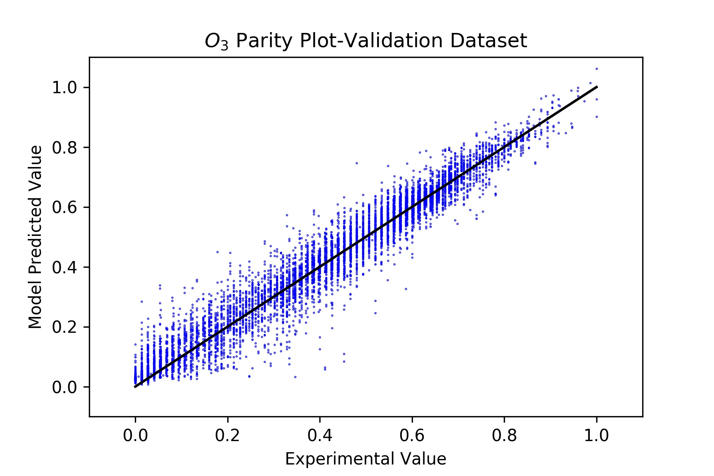
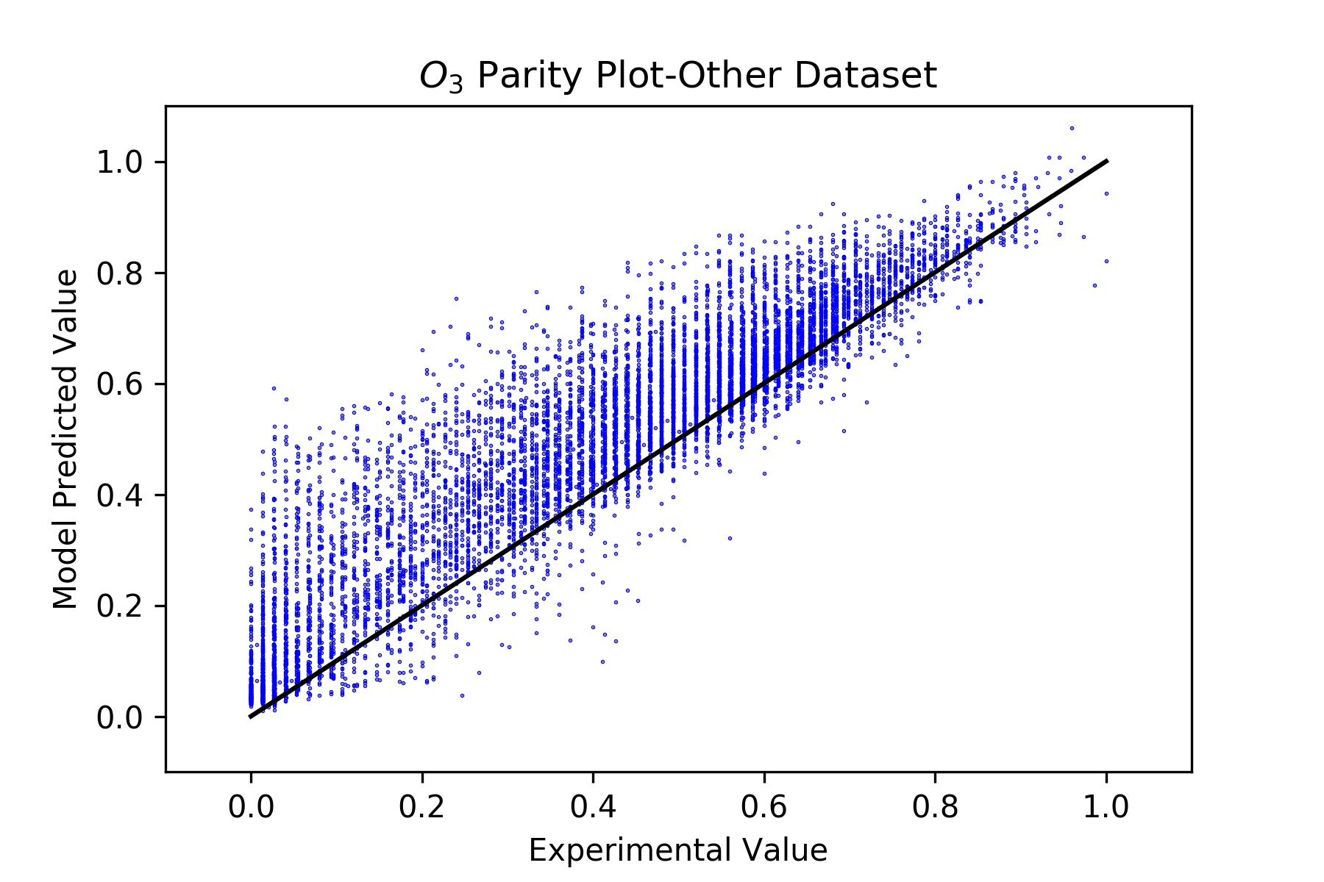
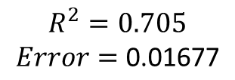
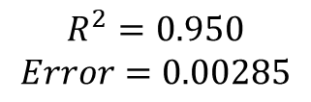
Some Results:
Still room for improvement!
$$R^{2}=0.950$$
$$Error=0.00285$$
$$R^{2}=0.705$$
$$Error=\text{0.01677}$$
Wow, but a bit expected…
Much better than the last time!

Slide 8
Was the error because of overfitting?... again
If we rework the training/evaluating neural networks work flow can we use an optimization function to get optimal parameters?

Slide 9
General Workflow-Optimizing Neural Networks
Normalized Test Data
Training
Data
Neural Network Train
Neural Network
MSE Error
Initial- nodes
Layers
learning rate
batch size
epoch
New Guess- nodes
Layers
learning rate
batch size
epoch
Optimize Function
Neural Network
When error is low

Slide 10


Issues
Neural Networks have been trained on Google Colab
Good for individual neural networks
Bad for optimizing neural networks
Google Colab often disconnects my optimization before it can finish
New solution:
Optimization for neural networks will be trained on Kaggle
Optimization is running now, so results will be posted soon!
In Short:
Both Google Colab and Kaggle’s Kernel will be used to train/evaluate neural network

Slide 11
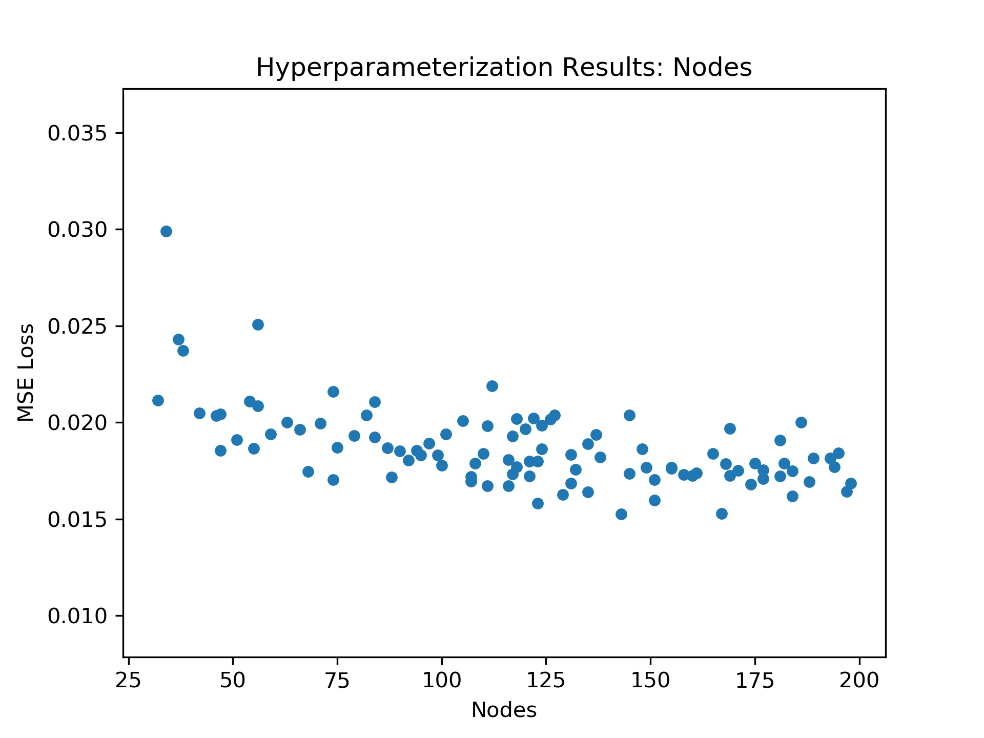
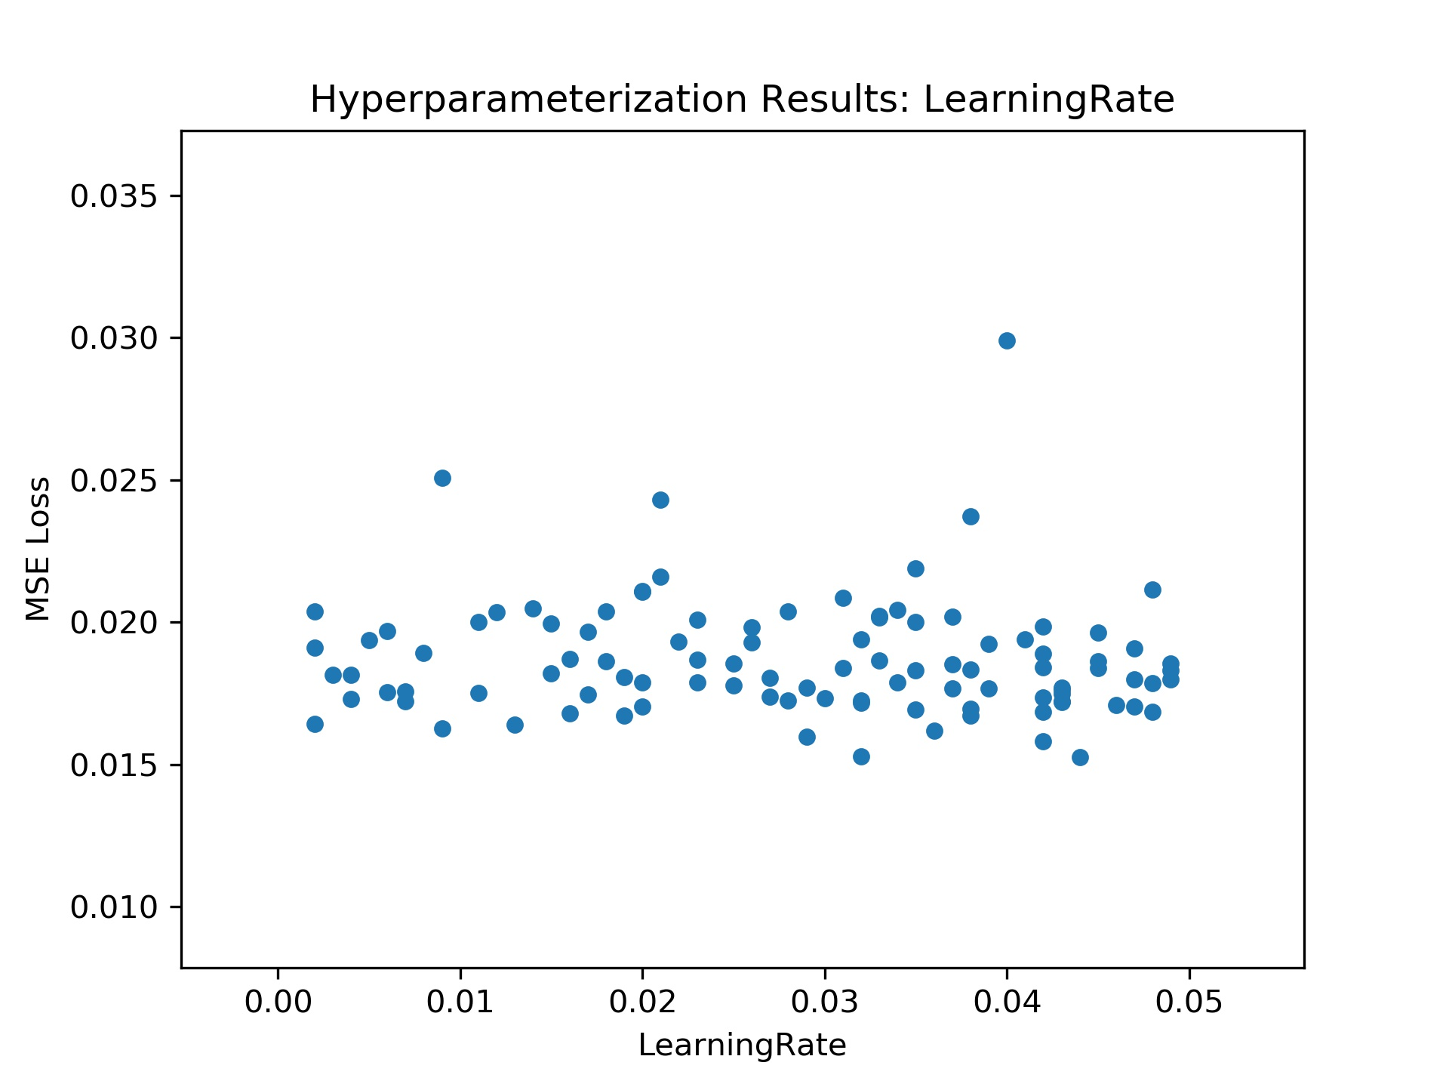
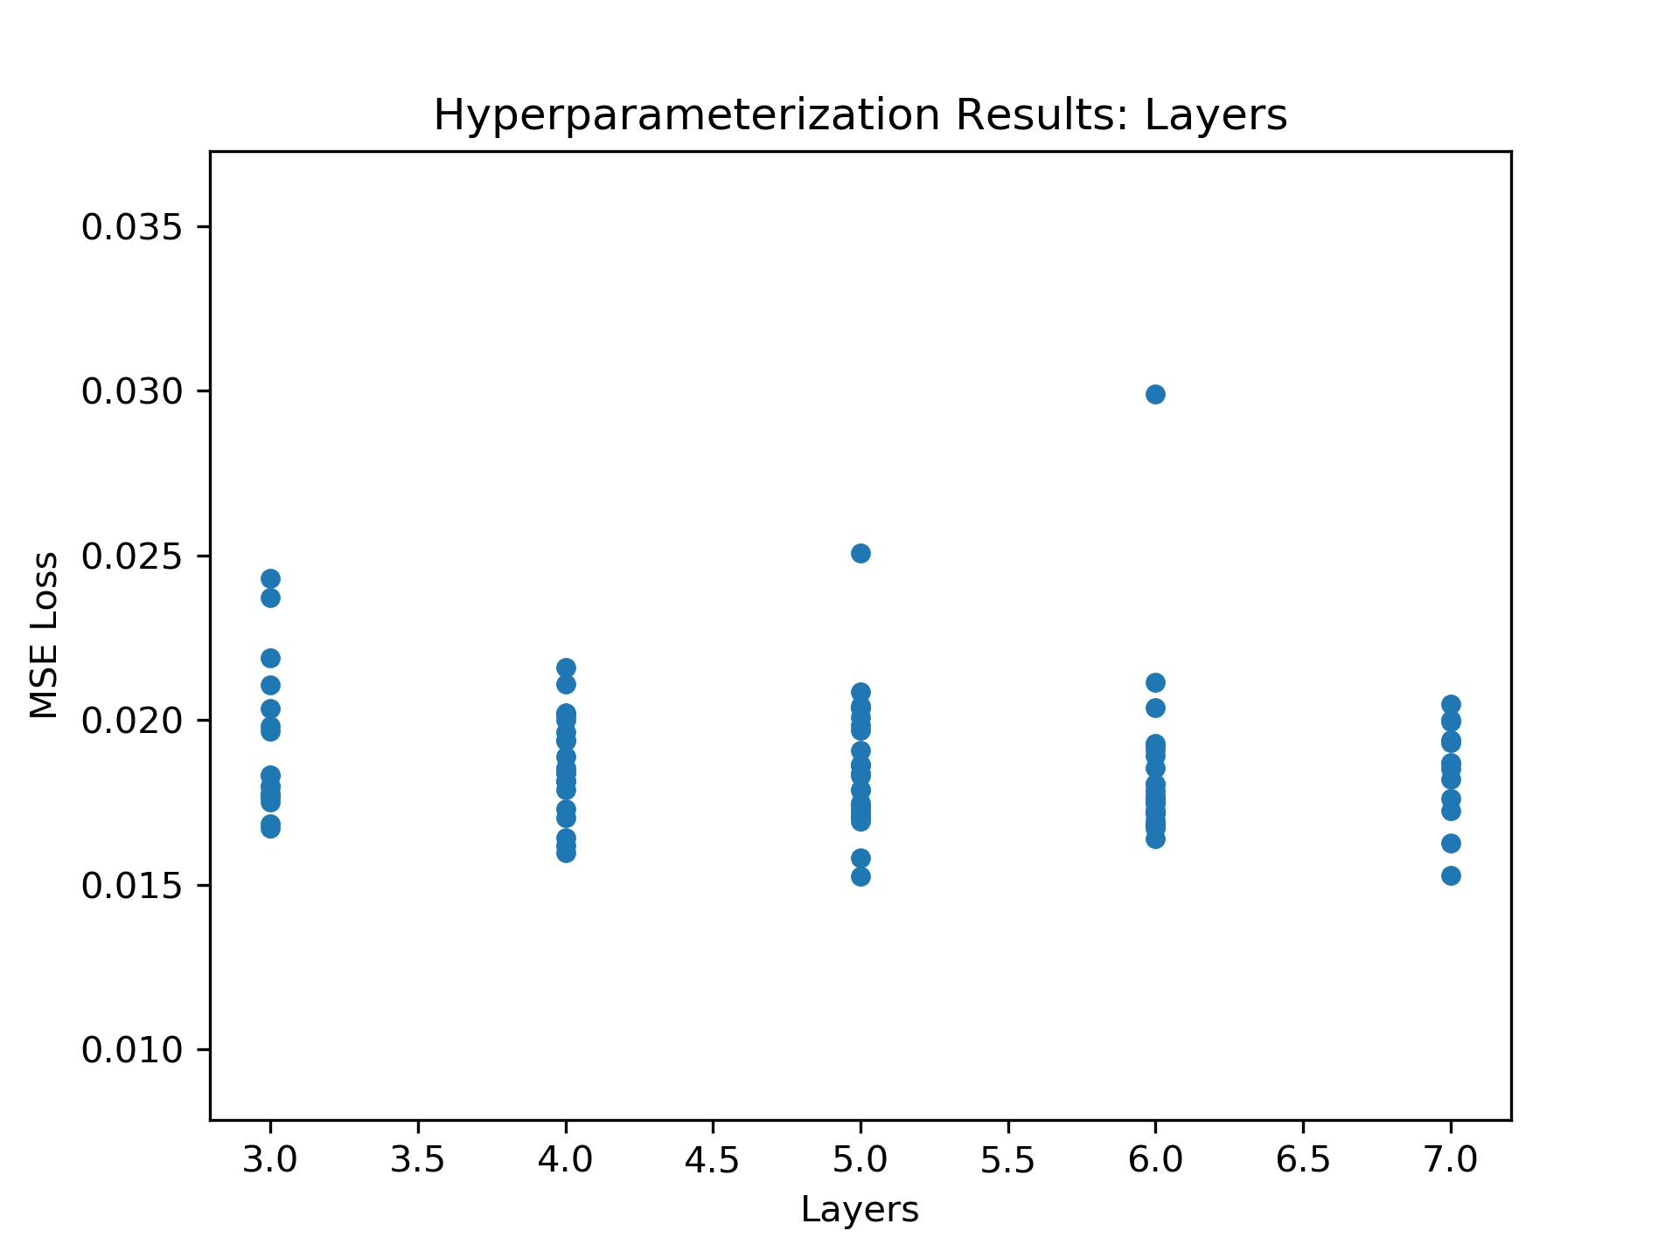
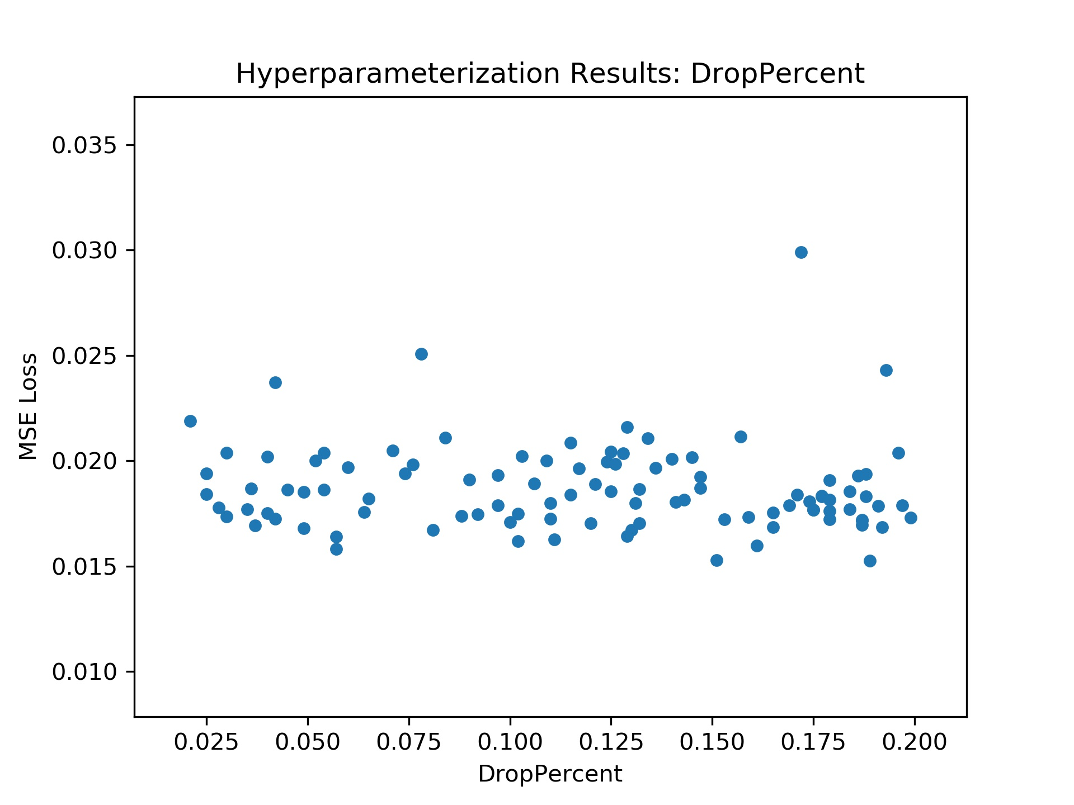
Results
Hyperparameter Optimization
Nodes
Layers
Drop Percent
Learning Rate

Slide 12
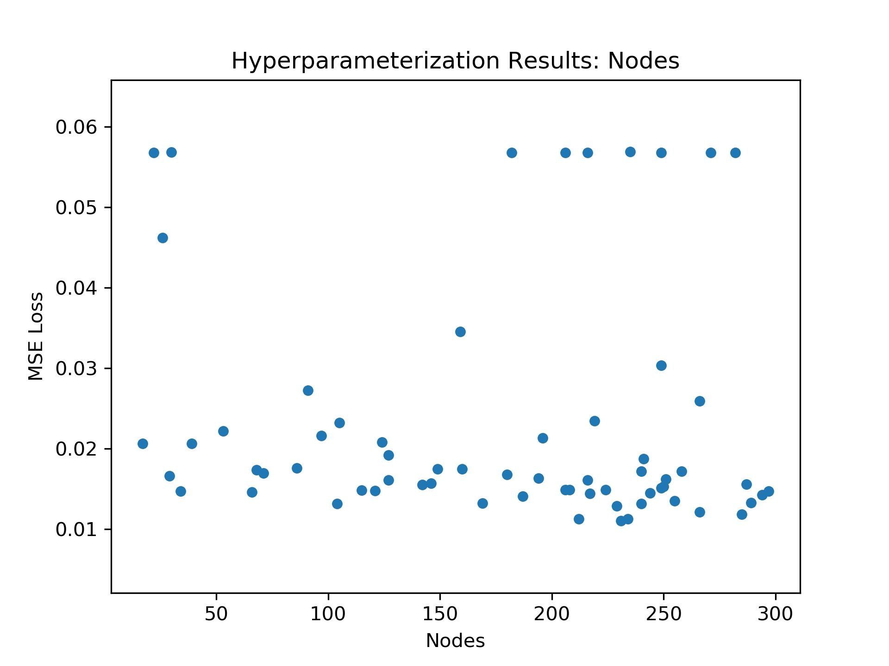
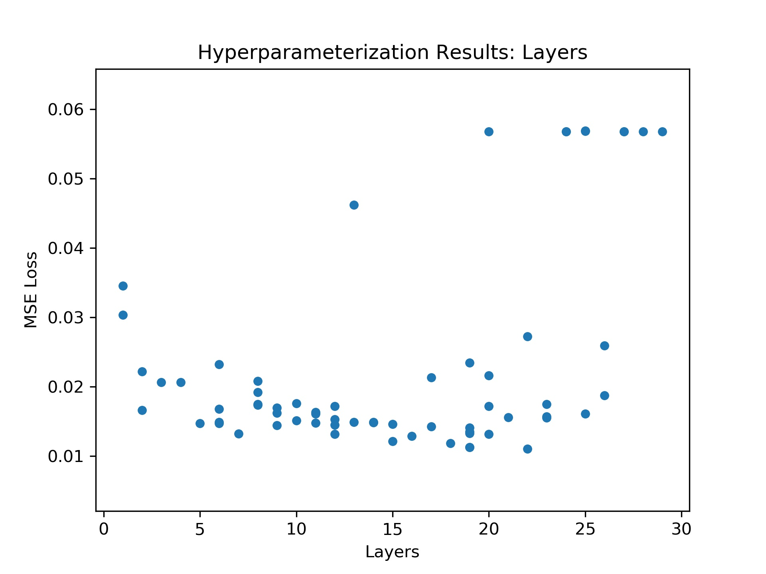
Results
We used the results to set:
Drop Percent
Learning Rate
Expand nodes and layer bounds

Slide 13
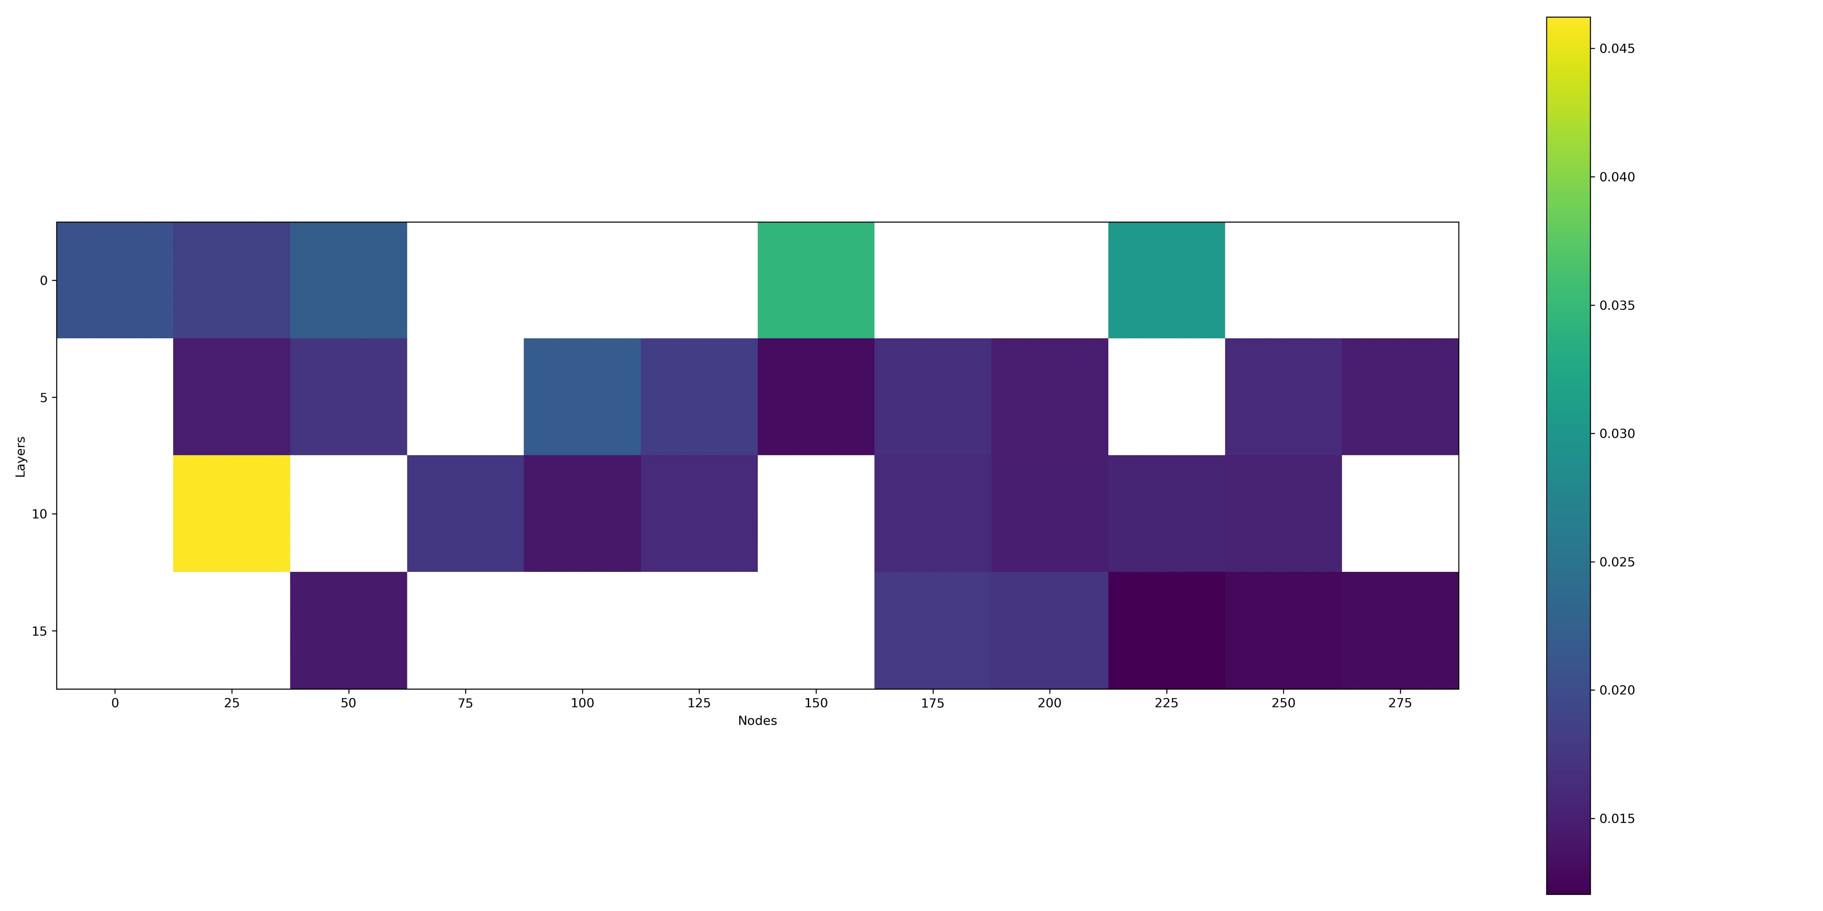
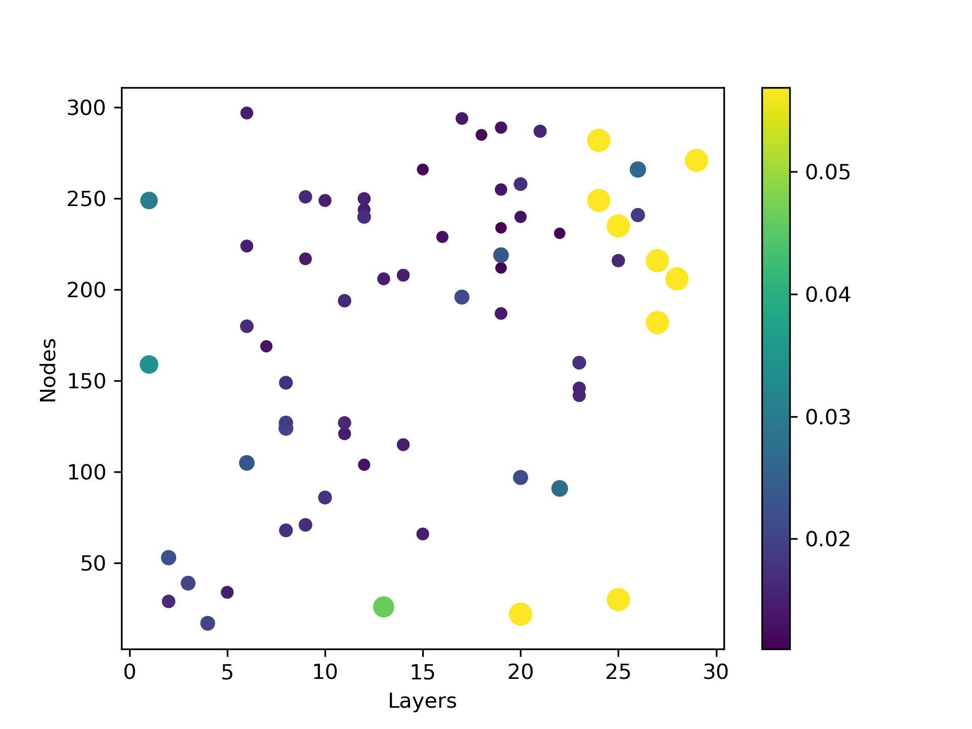
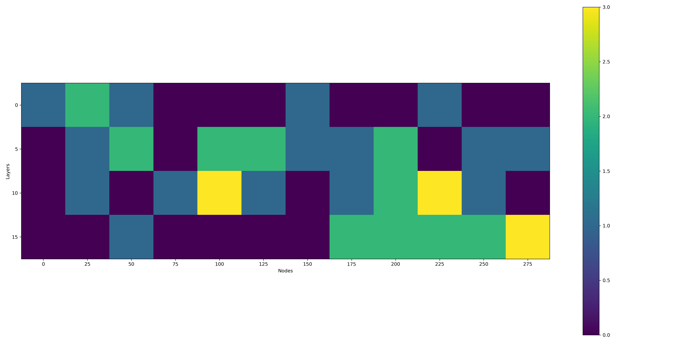
Results

Slide 14
Parameter Investigation
Lets do parameter analysis on a neural network trained using 150 nodes and 4 layers(Same as shown at the beginning of the presentation)

Slide 15
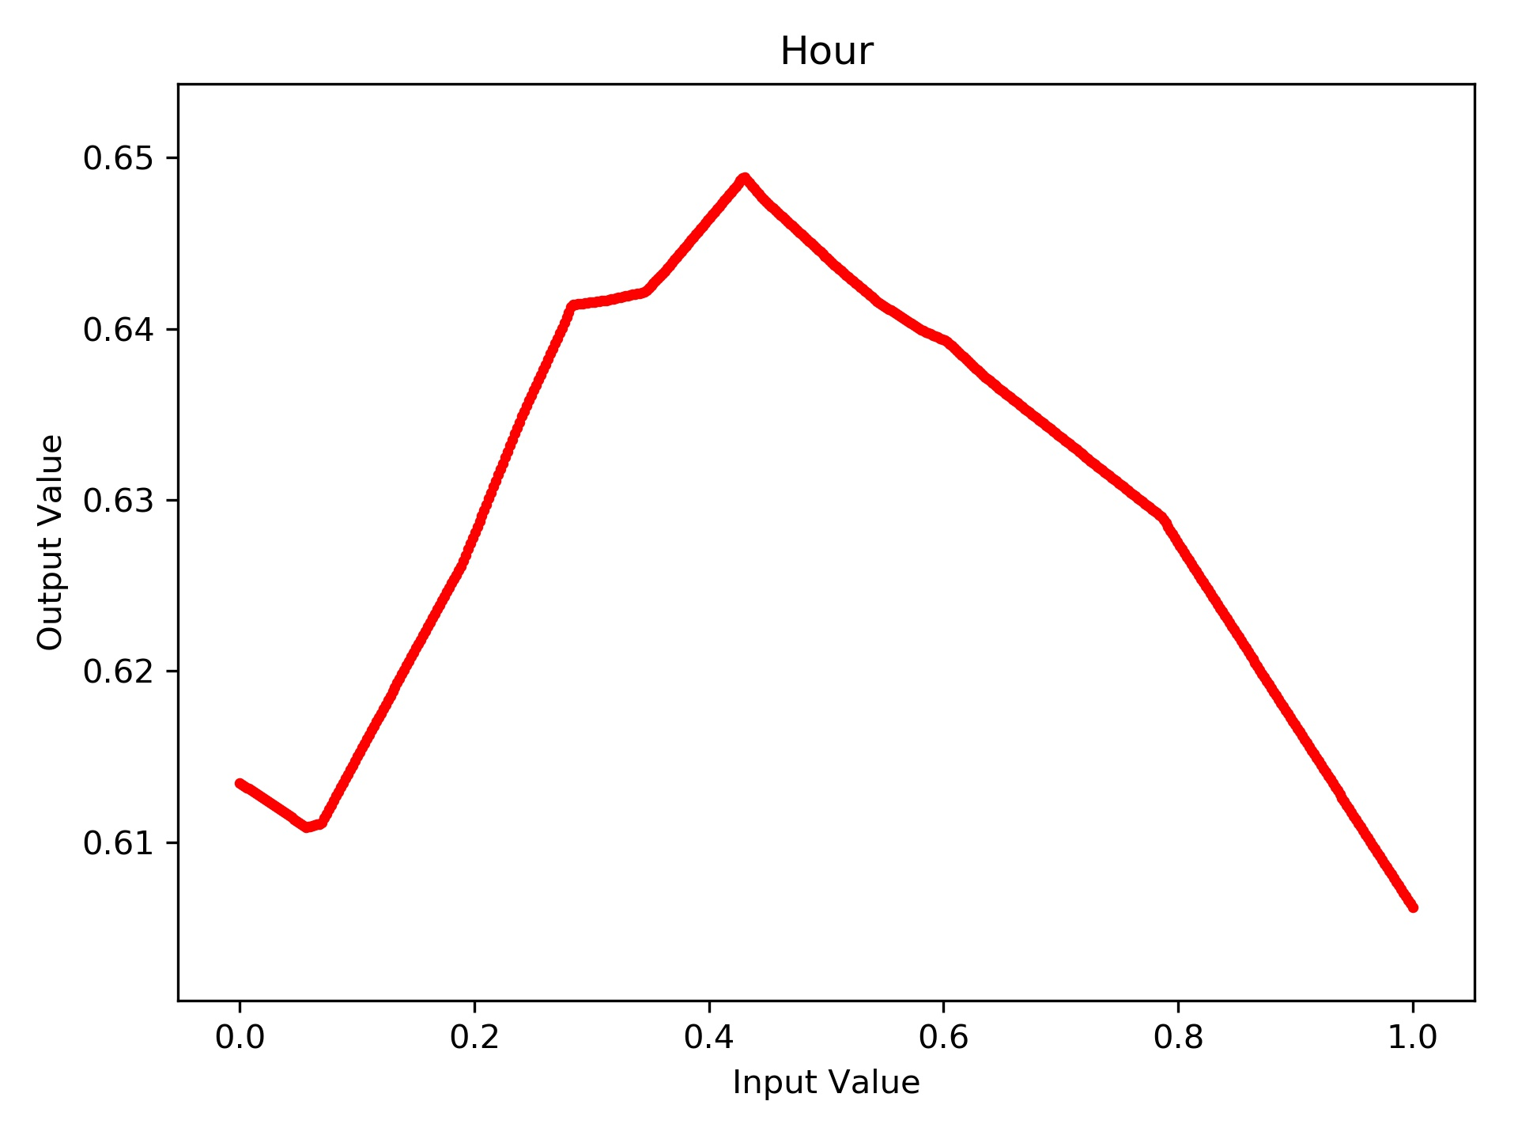
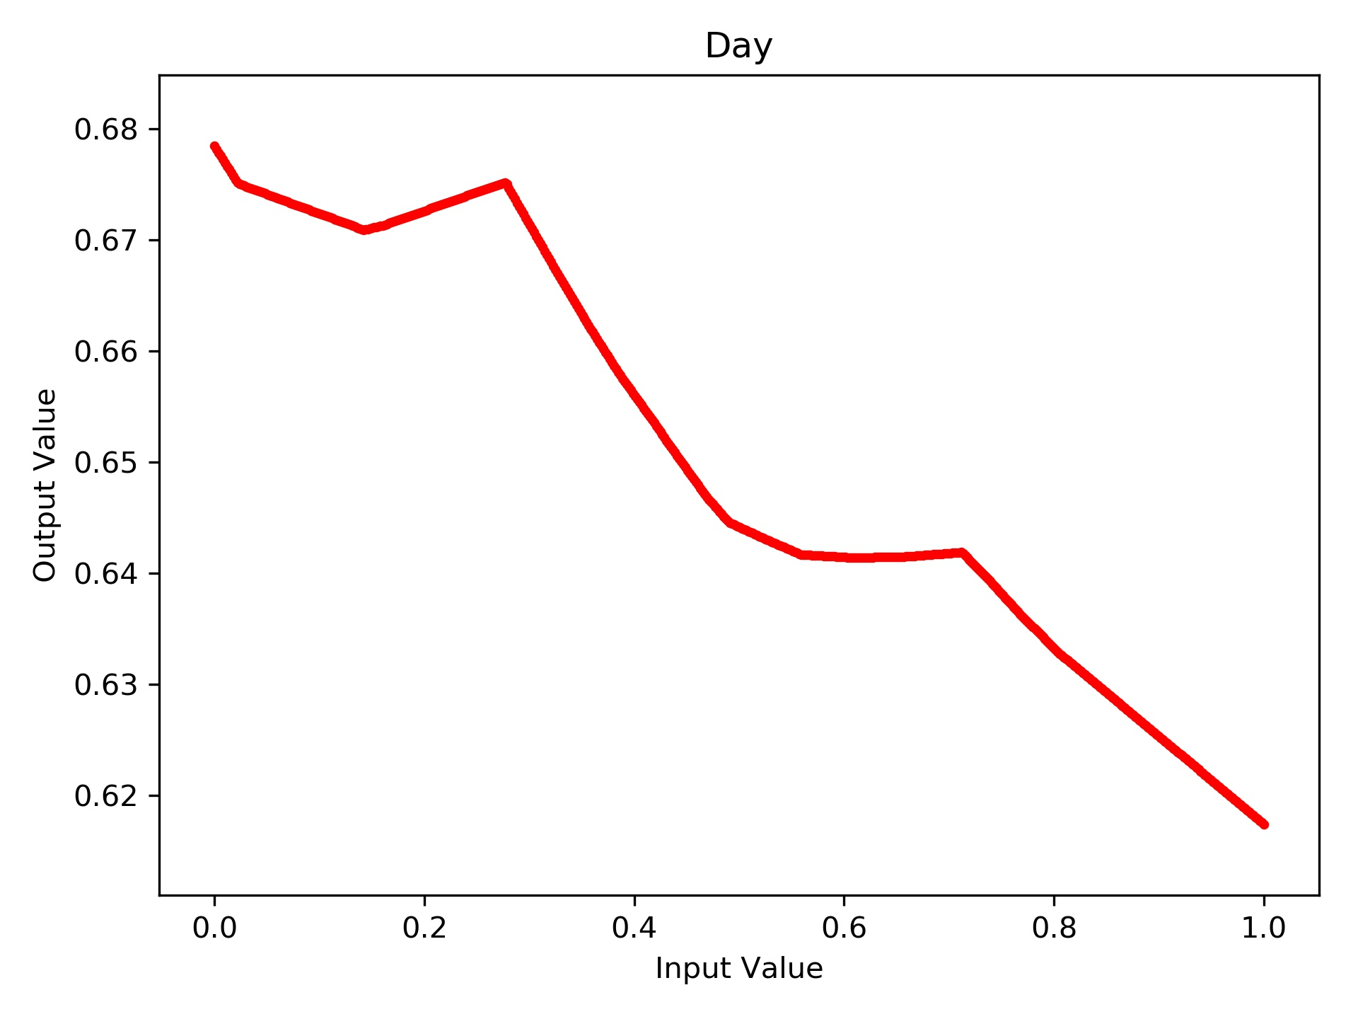
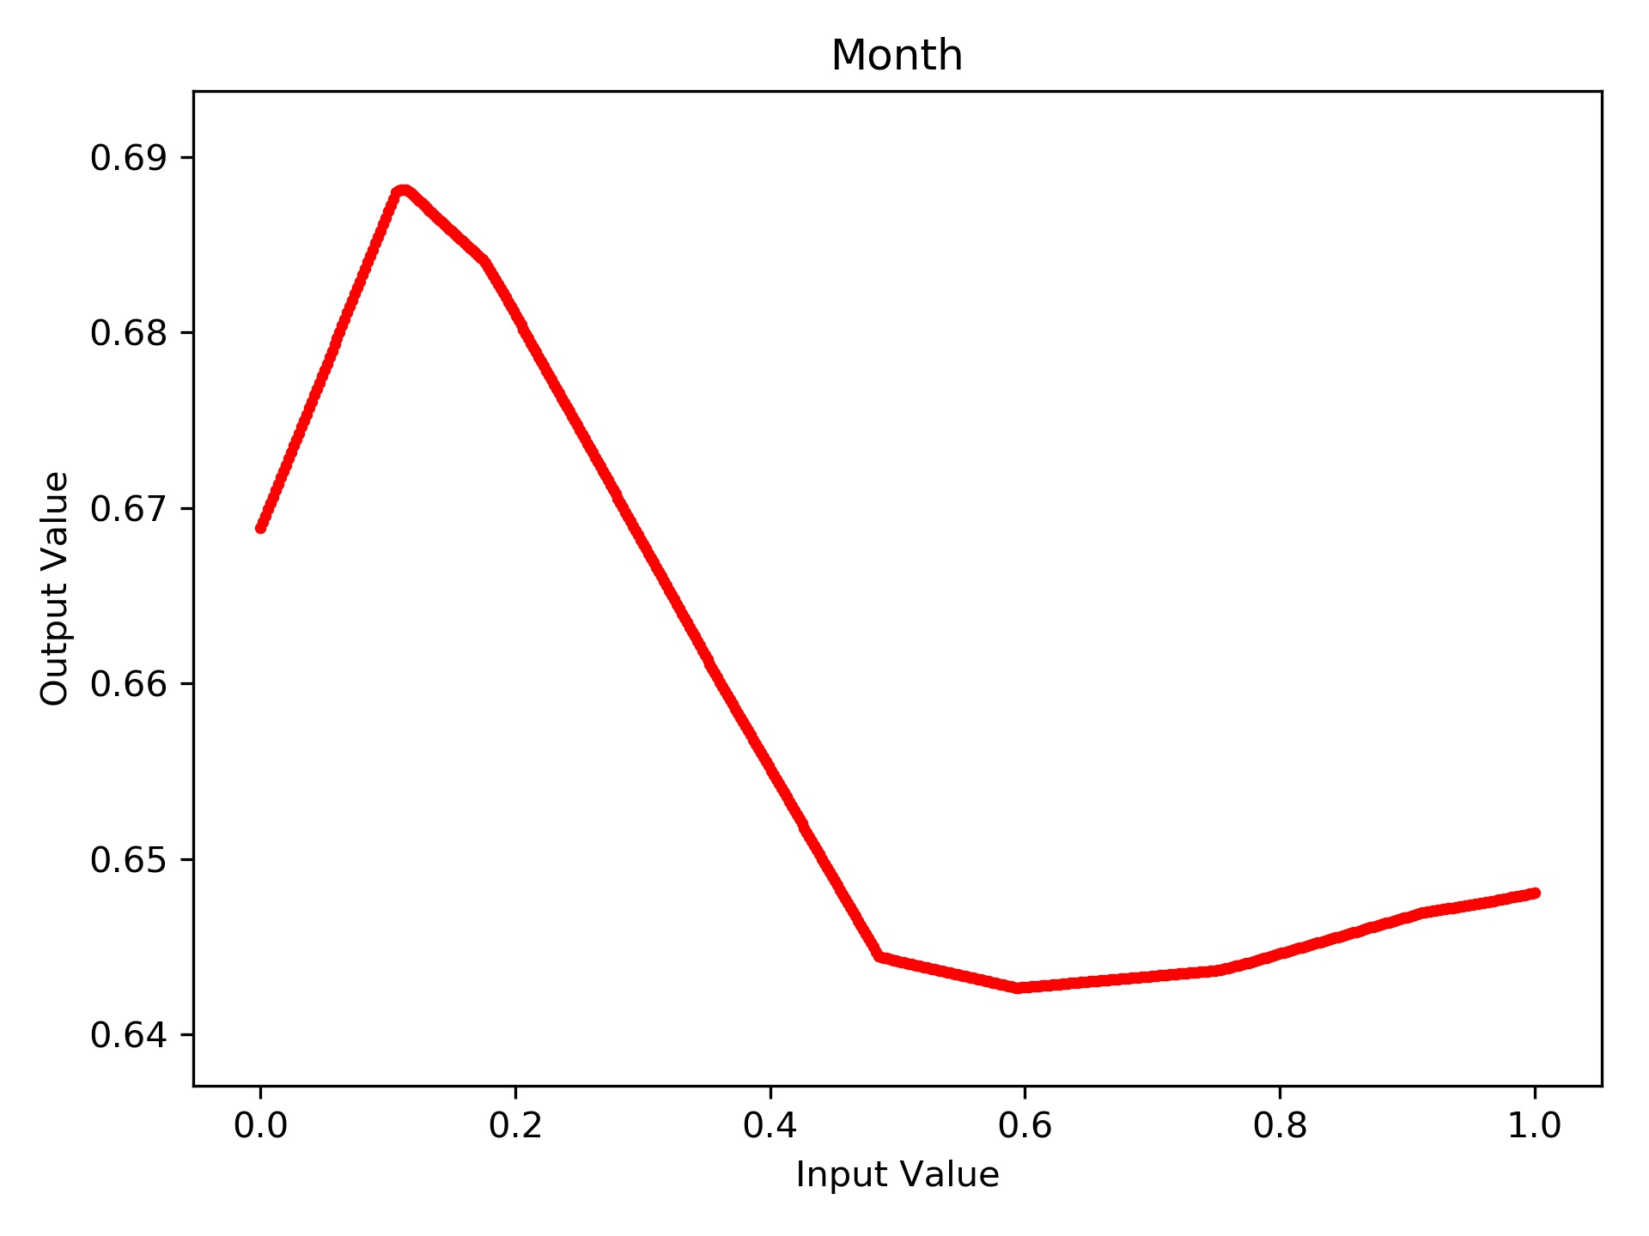
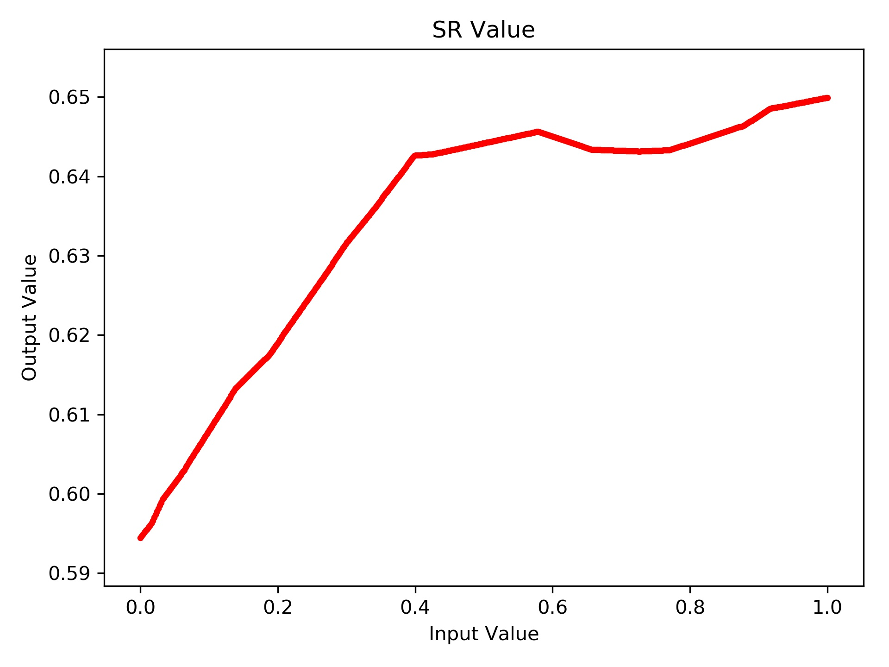
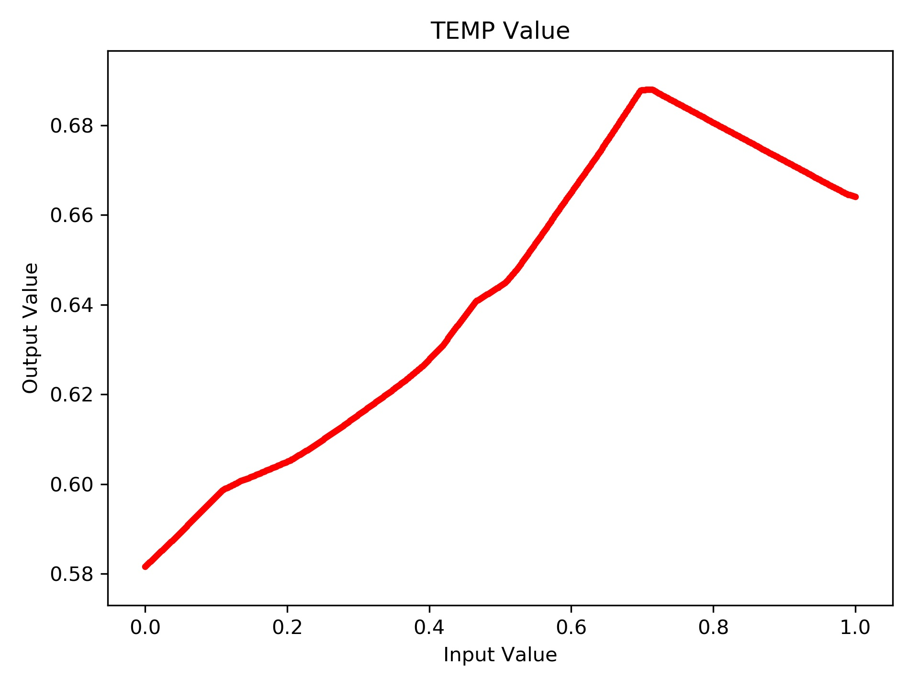
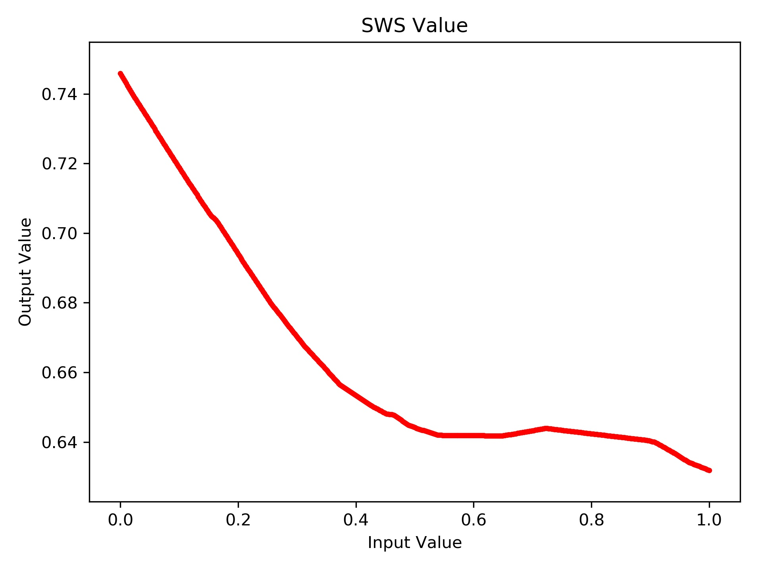
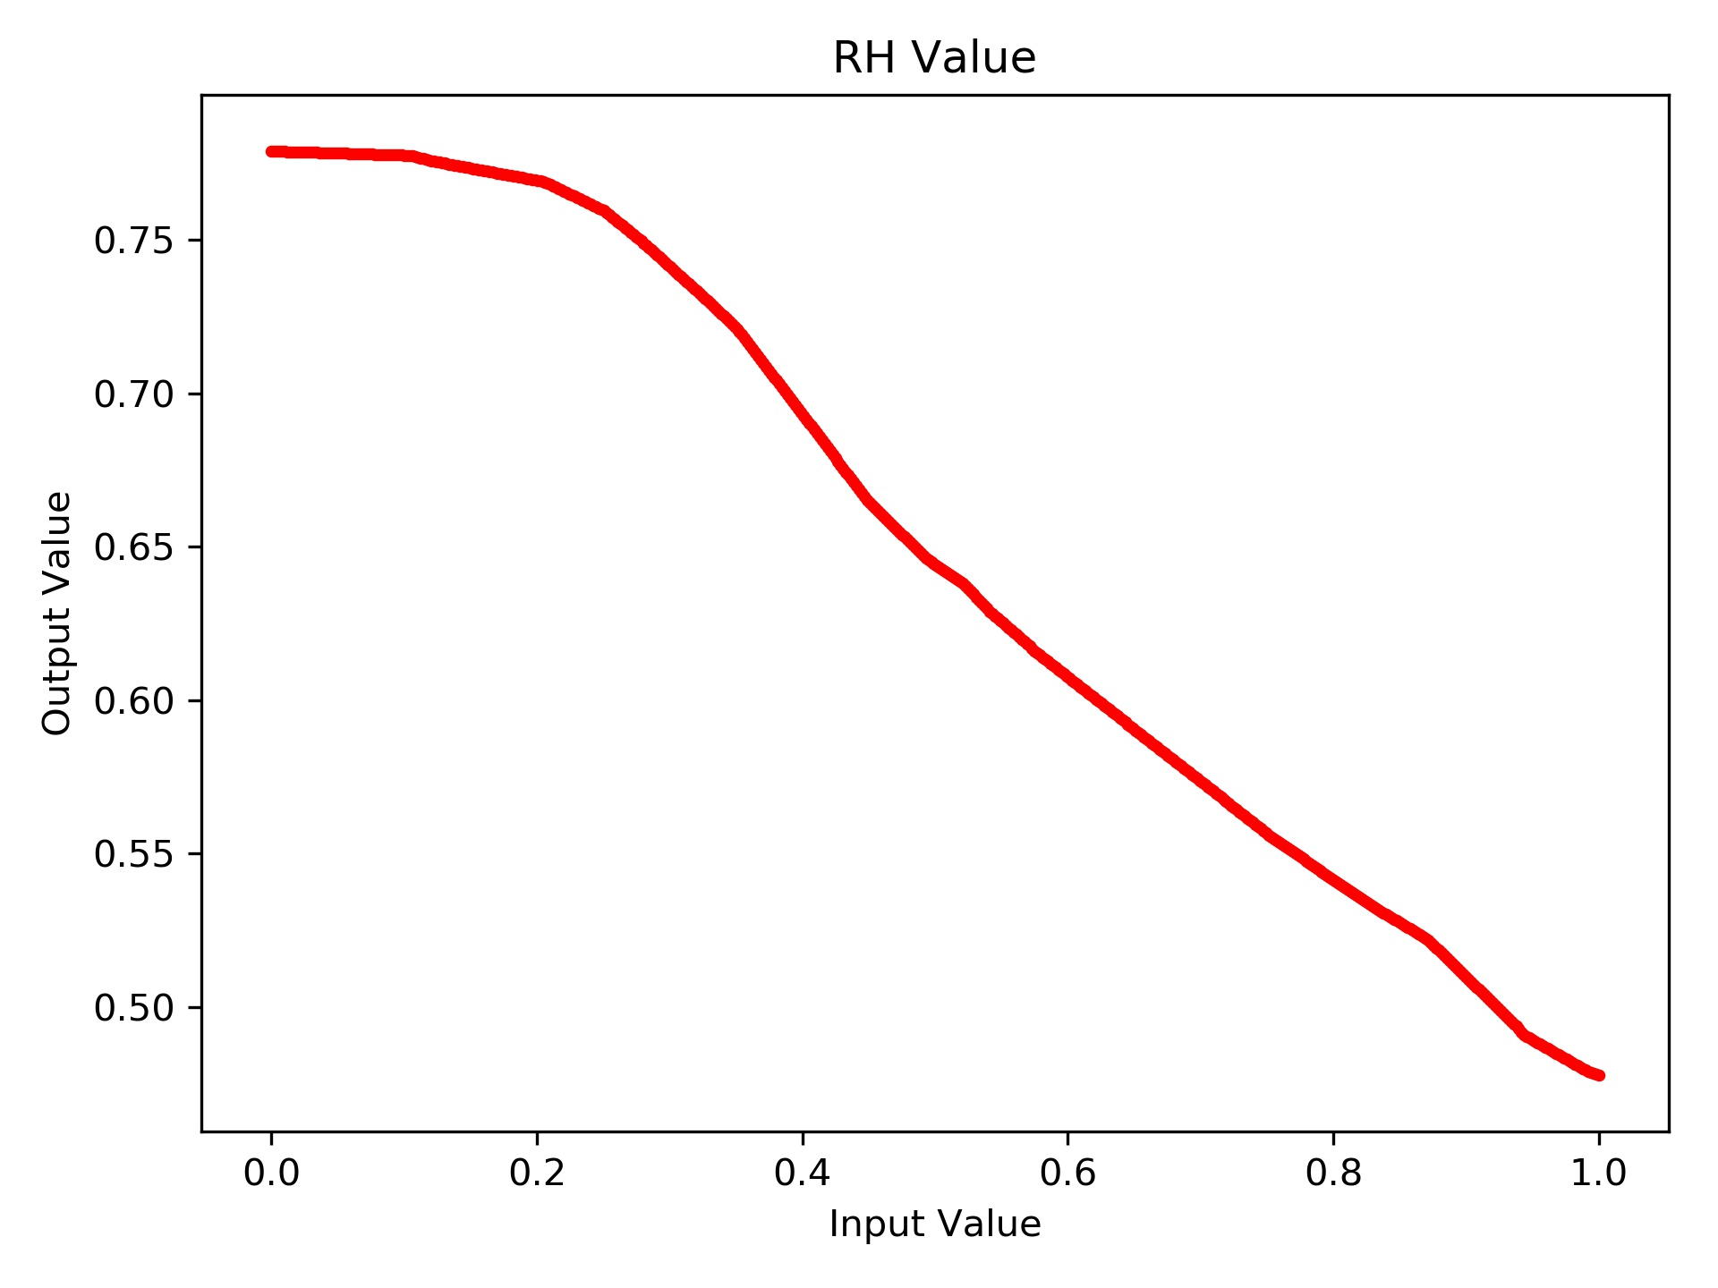
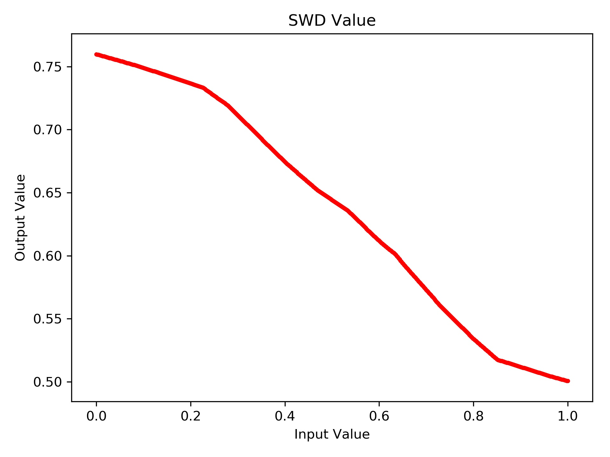

Slide 16
Current plan in the short term
Short Term Priorities
Look at ozone predictions from a time series point and see when the neural network is accurate and when it is not
Unnormalize the Ozone predictions and get the error in ppm
Longer Term Priorities
Remove some inputs and check the impact on the output
I have tried this, but haven’t had the time to visualize the input’s impact yet

Slide 17
Examples of Google Colab Notebooks
Training Individual Neural Networks
https://drive.google.com/open?id=1m9Xpt15_TZ68oDQMN7Jqm3hDKZzyUdUQ
Optimization
Bayesian: https://drive.google.com/open?id=113LhRw09kV22LxbkrjAuRwqv2AxxPLZn
Differential Evolution: https://drive.google.com/open?id=1SGf73Zc7px4l6JX-G9CYv_HouX1RhEDP
Folder Link: https://drive.google.com/open?id=1scUNIayoGwc7u9vIVQoUWZV-avNEO-0o

